Slide 1

Fiscal & Export Analysis
U.S. State Economic Landscape 2024-2025
April 2026 Update

Slide 2

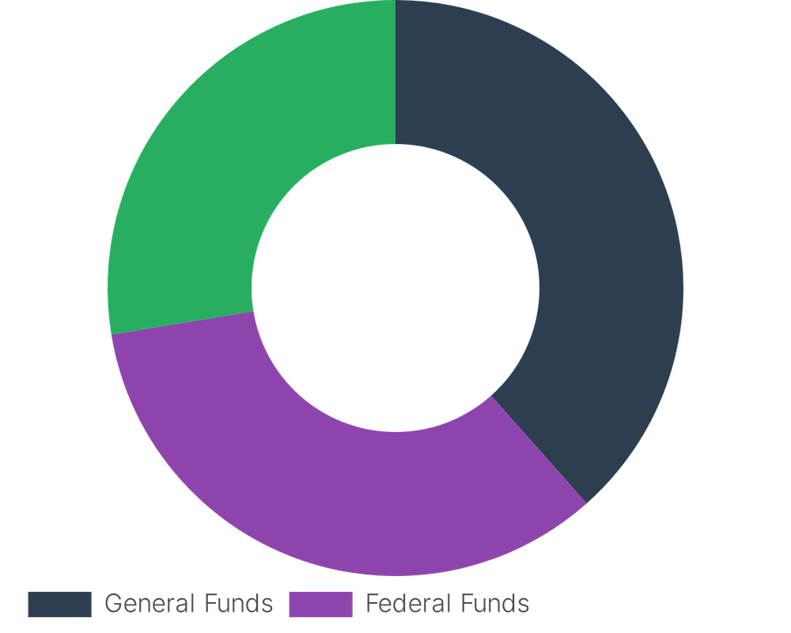
State Revenue Structures: Own-Source vs. Federal Aid
37.9%
General Funds (Own-Source)
33.5%
Federal Funds
27.2%
Other State Funds

Slide 3
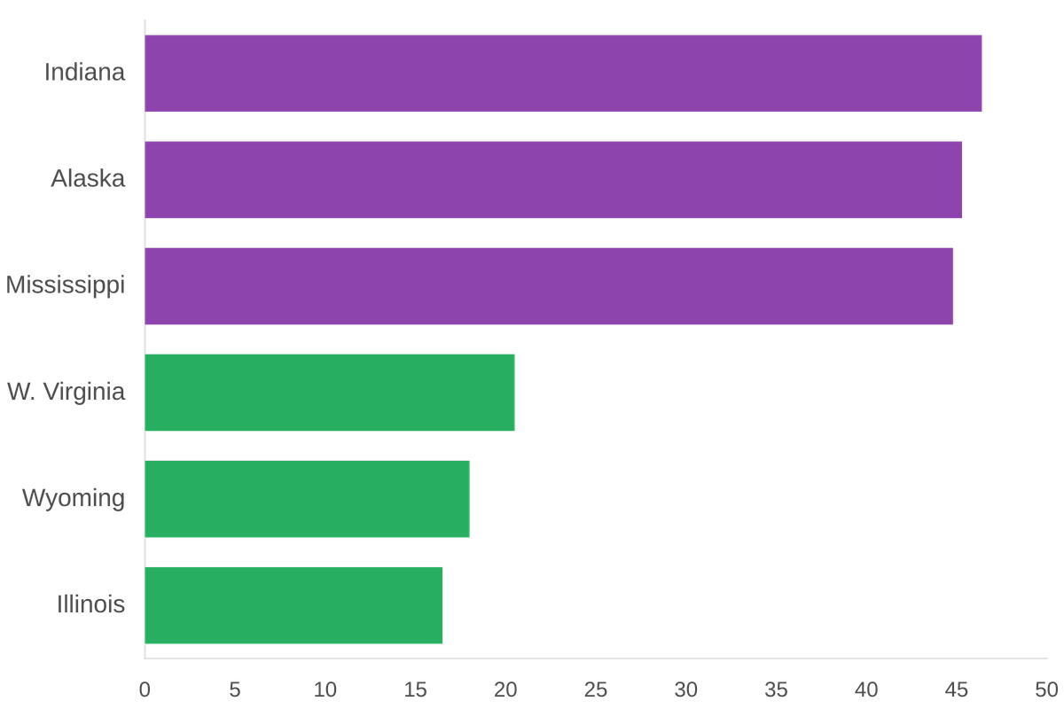
Federal Aid Dependency: Top & Bottom Performers
HIGH DEPENDENCY (TOP 3)
46.4% Indiana
45.3% Alaska
44.8% Mississippi
FISCAL AUTONOMY (BOTTOM 3)
16.5% Illinois
18.0% Wyoming
20.5% West Virginia

Slide 4
Texas and California Drive 30% of Total U.S. Exports
Texas
California
$450.3
$188.4
BILLION USD
BILLION USD
21.8%
8.6%
Share of Total U.S. Exports
Share of Total U.S. Exports
The economic concentration in these two states alone accounts for over 30% of the nation's international trade volume, driven by energy, technology, and aerospace sectors.

Slide 5



Top Export Commodities by State (2025)
Energy Hubs
Manufacturing
Tech & Aerospace
Texas
South Carolina
Washington
Crude Petroleum
Motor Vehicles
Aerospace Products
Louisiana
Alabama
Oregon
Natural Gas
Motor Vehicles
Electronic Circuits
North Dakota
Michigan
Arizona
Crude Petroleum
Motor Vehicles
Electronic Circuits

Slide 6
State Share of U.S. GDP: The Economic Heavyweights
14.2%
9.3%
8.1%
California
Texas
New York
Together, these three states contribute 31.6% of the total U.S. GDP. While the top tier remains stable, states like Florida (5.8%) and Illinois (4.1%) continue to anchor regional economic clusters, driving national growth through diverse industrial bases.

Slide 7

Export Performance Rankings (2025)
$2.18T
TOTAL U.S. EXPORTS
U.S. exports reached a record high in 2025, driven by global demand for energy and aerospace technology.
01
Texas
$450.3B
02
California
$188.4B
PRIMARY GROWTH DRIVERS
Energy price stabilization and a surge in aerospace manufacturing were the primary catalysts for export value increases across the top-performing states.
03
New York
$130.0B
04
Louisiana
$90.0B
05
Illinois
$75.0B

Slide 8
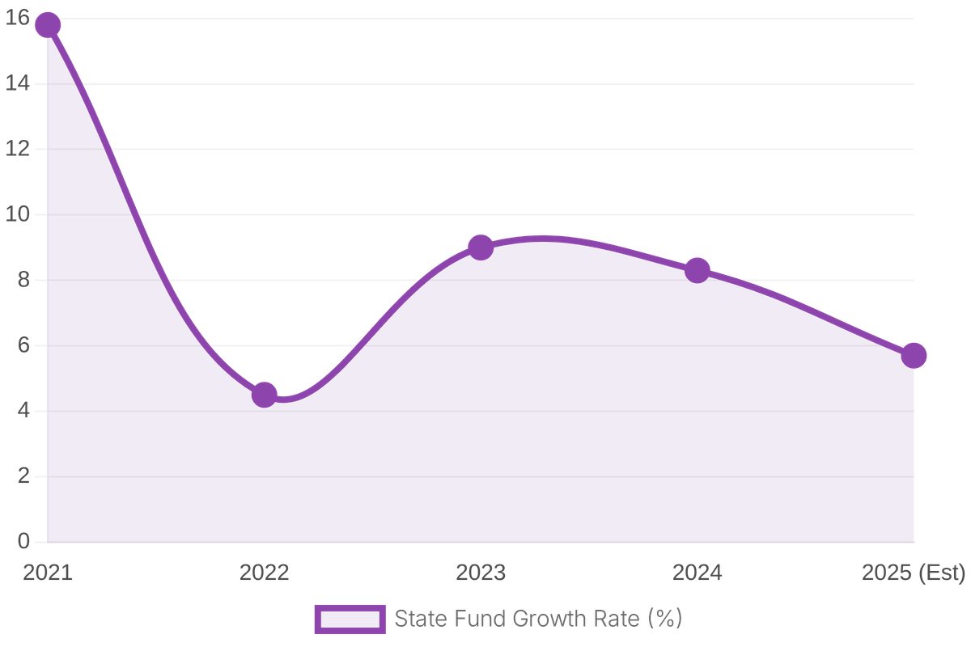
Fiscal Health: Own-Source Revenue Trends
5.7%
General Fund Growth
Estimated growth for FY 2025, reflecting a stabilization of state tax collections following pandemic-era volatility.
1.4%
Bond Financing Share
Bonds represent a minimal portion of total revenue as states leverage existing surpluses for capital investments.

Slide 9

Summary of State Rankings
MOST EXPORT-INTENSIVE
MOST FEDERALLY DEPENDENT
Texas
Indiana
$450.3B
46.4%
Total Export Value
Federal Aid Share of Revenue
LARGEST GDP CONTRIBUTOR
LEAST FEDERALLY DEPENDENT
California
Illinois
14.2%
16.5%
Share of Total U.S. GDP
Federal Aid Share of Revenue

Slide 10
Conclusion & Data Outlook
01
02
03
ECONOMIC RESILIENCE
FISCAL STABILITY
DETAILED INSIGHTS
U.S. states demonstrate significant resilience through diversified exports and stable revenue growth patterns.
Federal aid is expected to stabilize as pandemic-era programs wind down, shifting focus to state own-source revenue.
Comprehensive state-by-state rankings and fiscal breakdowns are available in the accompanying Excel report.
Prepared for Fiscal Analysis Review | April 2026

